Slide 1
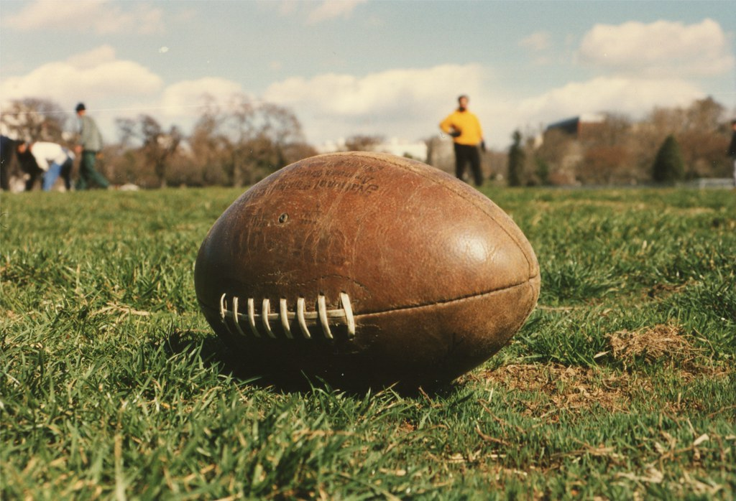
Show What You Know
Todd Van Ritchie
Football Ellipse by Elvert Barnes is licenced under CC 4.0

Slide 2
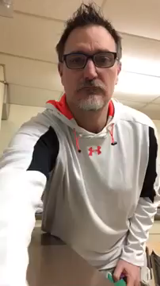
Juggling
Here I am teaching and demonstrating the basics of two ball juggling.

Slide 3
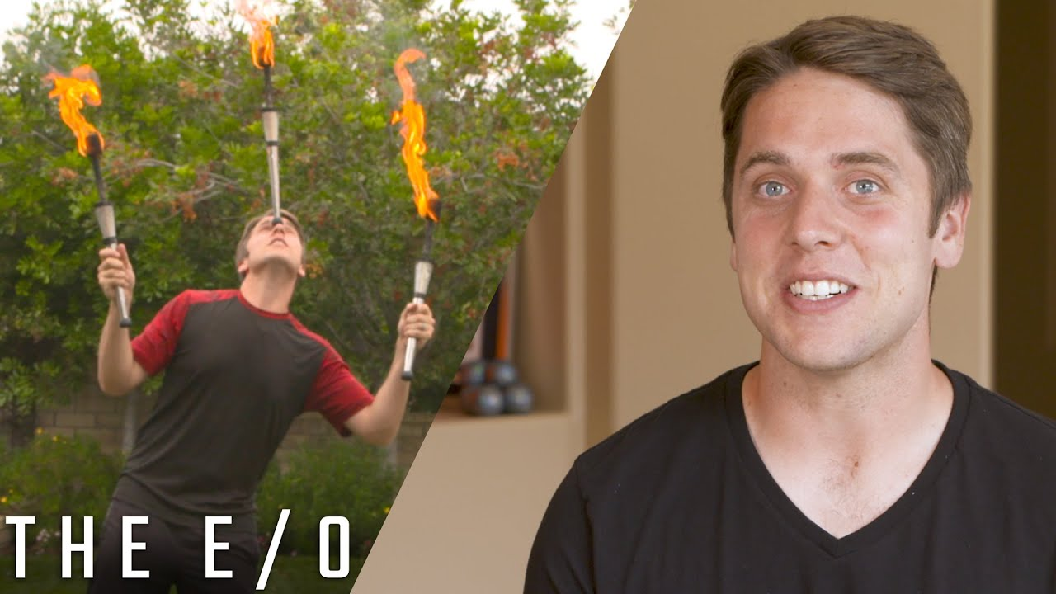
Professional Juggler Josh Horton
Josh Horton is a professional juggler and world record holder.
Video:
https://youtu.be/Zc6oNuc-w00
News story about being a juggler
https://www.firstcareers.co.uk/careers/what-does-a-professional-juggler-do/

Slide 4
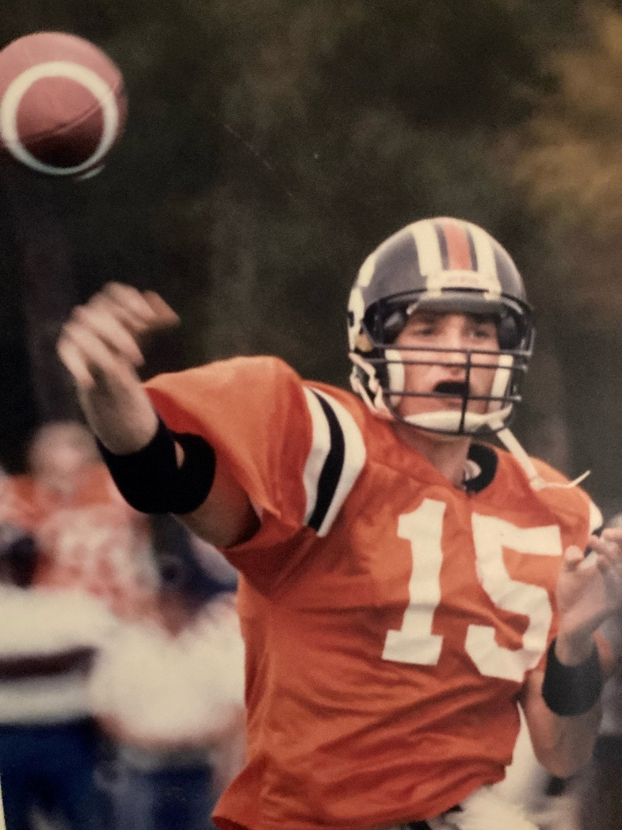
Personal Sport Info - Football
This is a picture of me playing football for the Ottawa Sooners taken by a reporter from the Ottawa Citizen in October 1992. It was from a game against the Hamilton Hurricanes.

